Slide 1


SQL Saturday in Albany, NY July 29th, 2018 Pre Con: R from A to Z
http://www.sqlsaturday.com/694/EventHome.aspx
SQL Saturday in Boston, MA September 22, 2018
Use Discount Code Microsoft
For 20% Off
https://r_programming.eventbrite.com

Slide 2
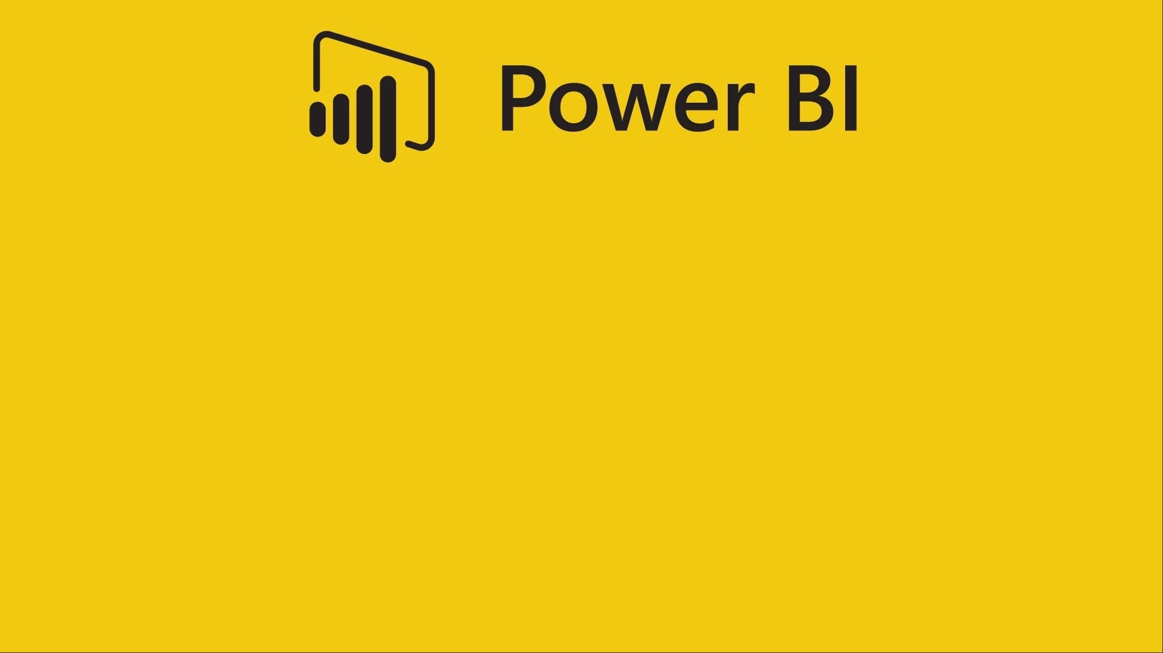

Giving SupeR Powers to Power BI
by Bryan Cafferky

Slide 3

Some Things R Better Together

Slide 4
R is to Power BI as…

Slide 5

Underdog’s Ring is to Underdog

Slide 6

Spinach is to Popeye

Slide 7

The Utility Belt is to Batman

Slide 8


For Language and graphics

Slide 9
Presentation Goals
Why Do We Need R?
R Primer
R as a Data Source
R Transformations
R Visuals
Slides Available at:
https://github.com/bcafferky/shared/tree/master/PowerBIwithR

Slide 10
What is R?
R is an open source language for Data Science.

Slide 11
Why Use R?
Can do things in Power BI that cannot be done without it.
Tell stories involving machine learning.
Show the research, i.e. how did we get here.
Extend your skillset.
Data Exploration.

Slide 12
R Features
Scripting language like Python, BASH, Perl, or PowerShell.
Vast library of statistical functions.
Support to create impressive visualizations.
Extensive free open source libraries by the user community.

Slide 13

Getting Things Set Up

Slide 14


Get and Install R and R Studio
R CLI – Command Line interface.
https://cran.r-project.org/bin/windows/base/
Designed for interactive single command at a time. Must install this.
R Studio – An Integrated Development Environment.
https://www.rstudio.com/products/rstudio/download/
A complete script development environment.

Slide 15
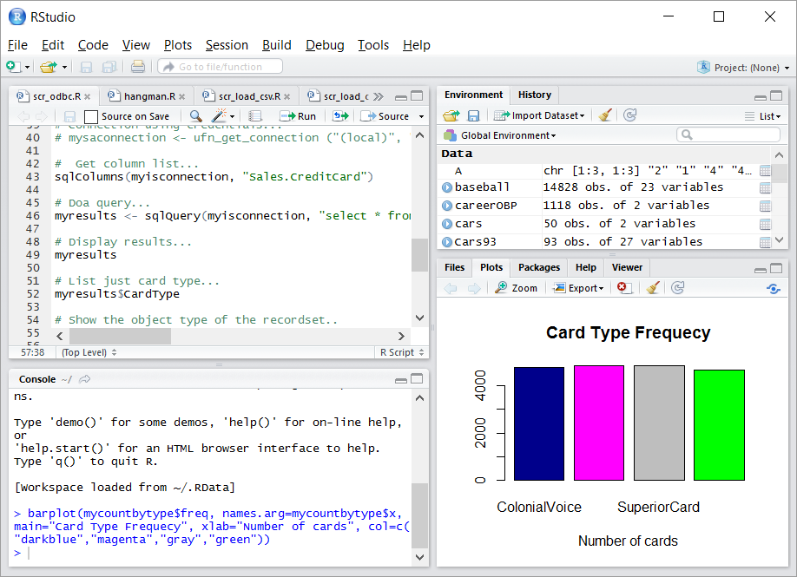
RStudio
Environment Memory
Script Editor
Tabbed Views
R Console

Slide 16
R Primer
R Studio
Vectors
Data Frames
Visualizations

Slide 17

It was rumored that the Apple logo was in honor of this pioneer of Computer Science.

Slide 18
It was rumored that the Apple logo was in honor of this pioneer of Computer Science.
Alan Turing – an apple with a bite out of it was found next to him.

Slide 19
Using R with Power BI
Supported R Packages
https://docs.microsoft.com/en-us/power-bi/service-r-packages-support

Slide 20
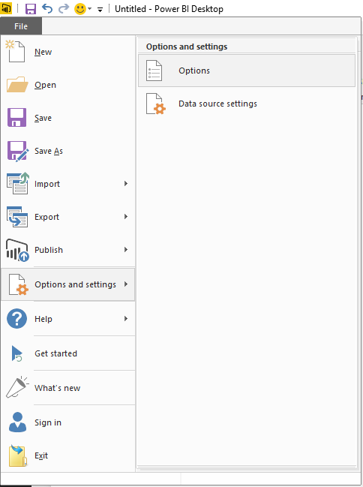
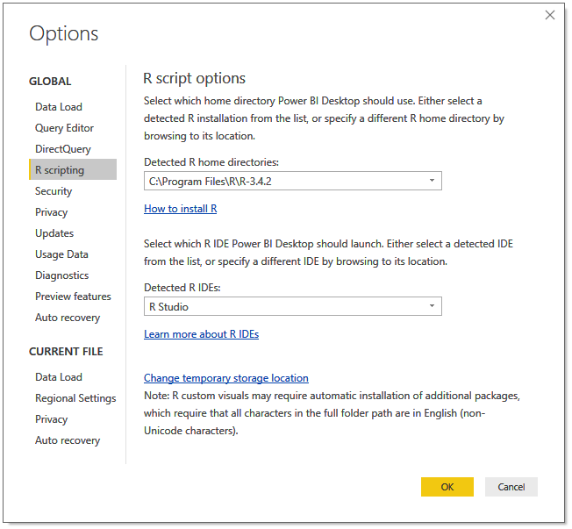
Enabling R Scripts
Select Options

Slide 21
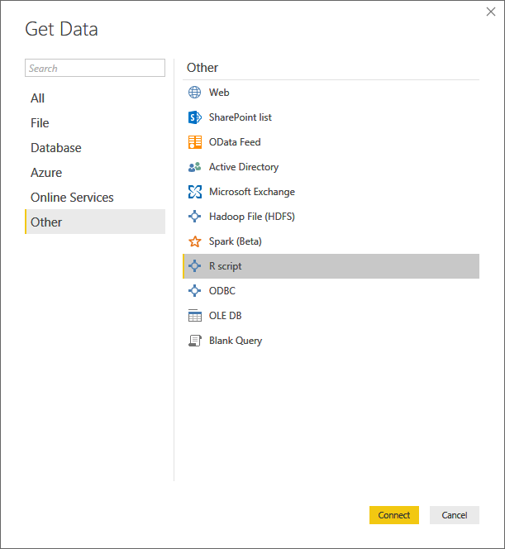
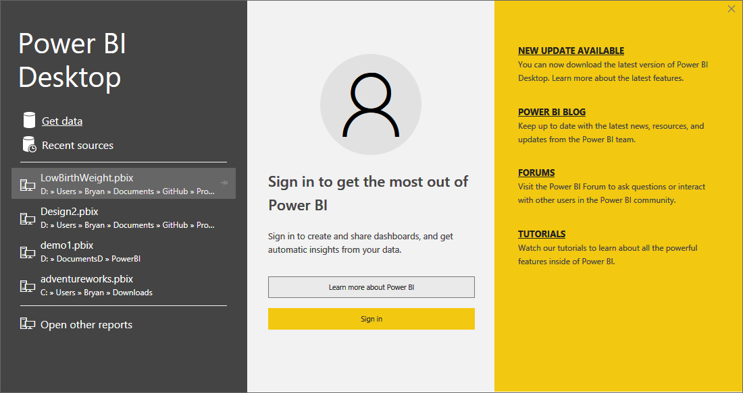
Power BI R Script as a Data Source

Slide 22
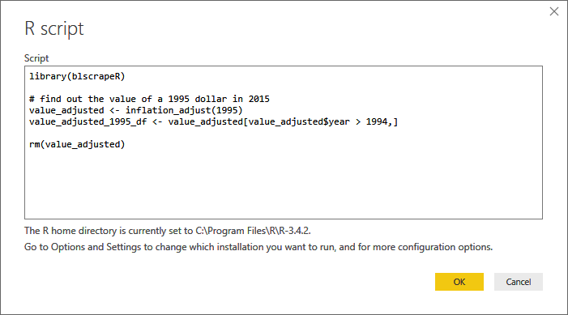
Power BI R Script as a Data Source
Unsupported Package
Load an installed package.
Function returns a data frame.
New data frame based on value_adjusted
Remove unneeded data frame.

Slide 23
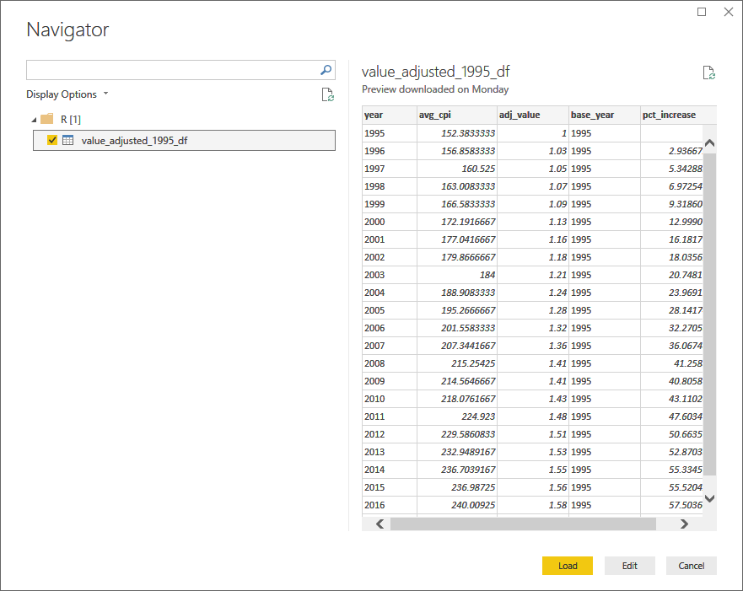
Power BI R Script as a Data Source

Slide 24
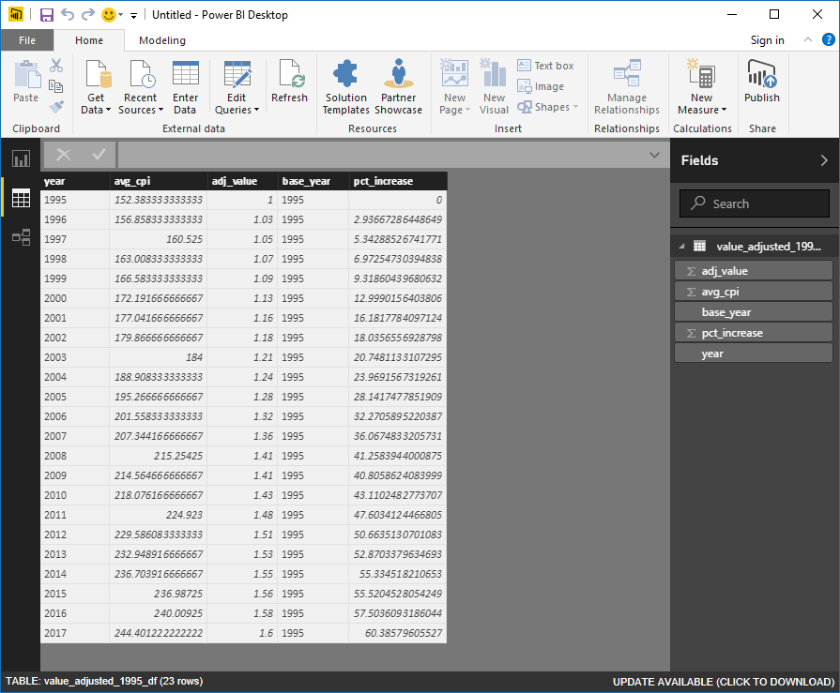
Power BI R Script as a Data Source

Slide 25
Demo
Loading Data from an R Script
r_adjusted_values_load.r

Slide 26
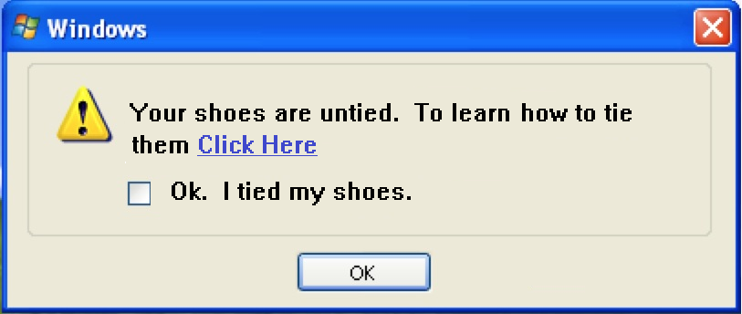
Windows with AI Enabled

Slide 27
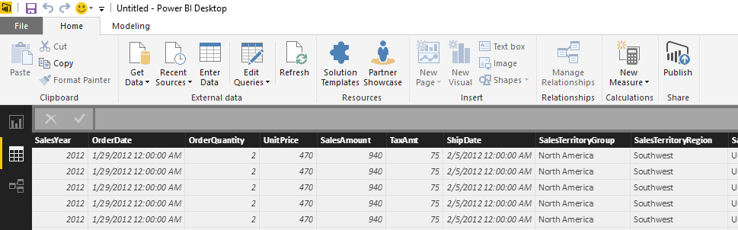
Transformation Script
Click on Edit Queries

Slide 28
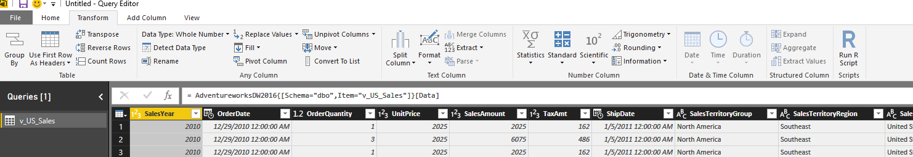
Transformation Script
Click on Transform
Click on Run R Script

Slide 29
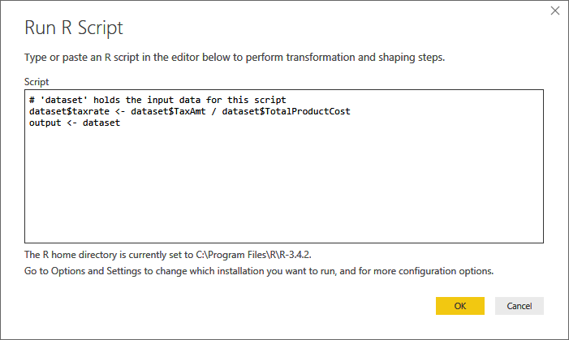
Transformation Script
Power BI Passed Data In as the dataset data frame.
Data is returned via the output data frame.

Slide 30


Slide 31
Demo
Transforming Data from an R Script
scr_transformation.r
Scr_power_bi_sales_adjusted_measure

Slide 32
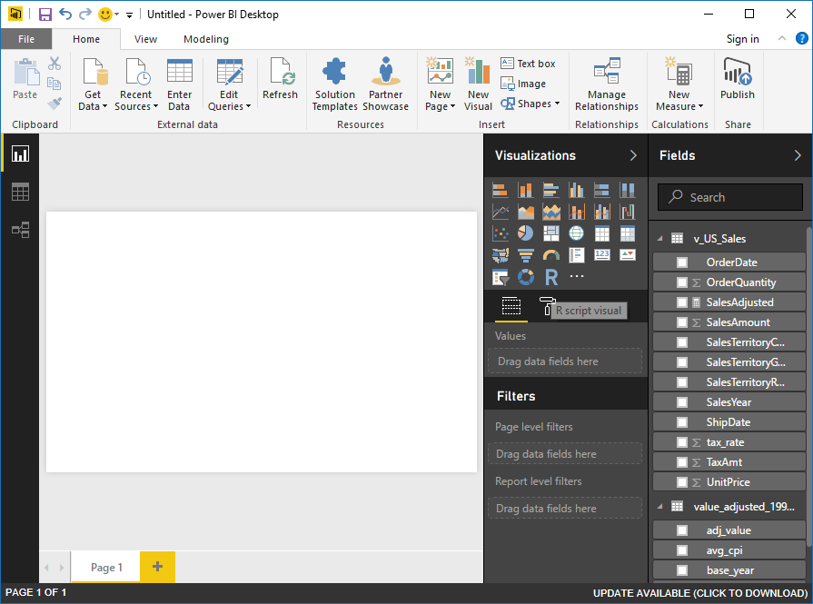
Visualizations with R
Click on R

Slide 33
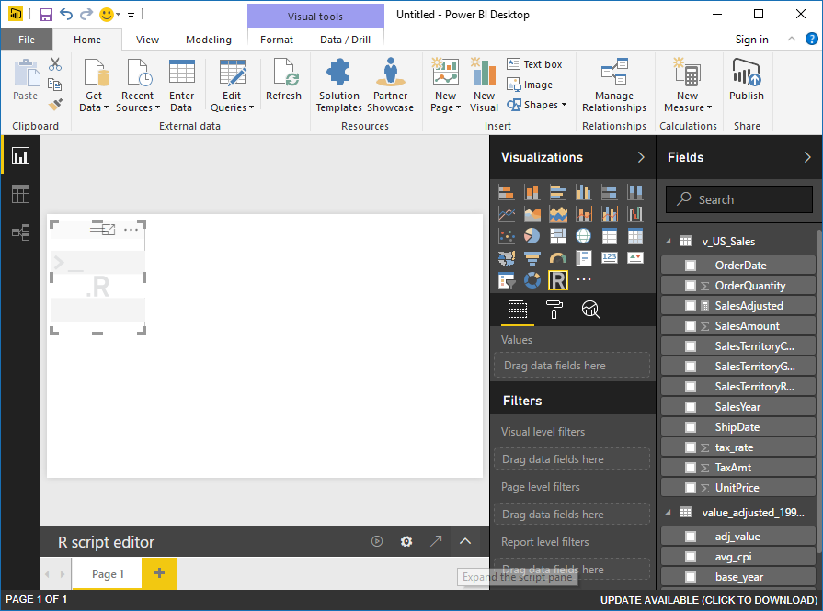
Visualizations with R
Expand Code Window

Slide 34
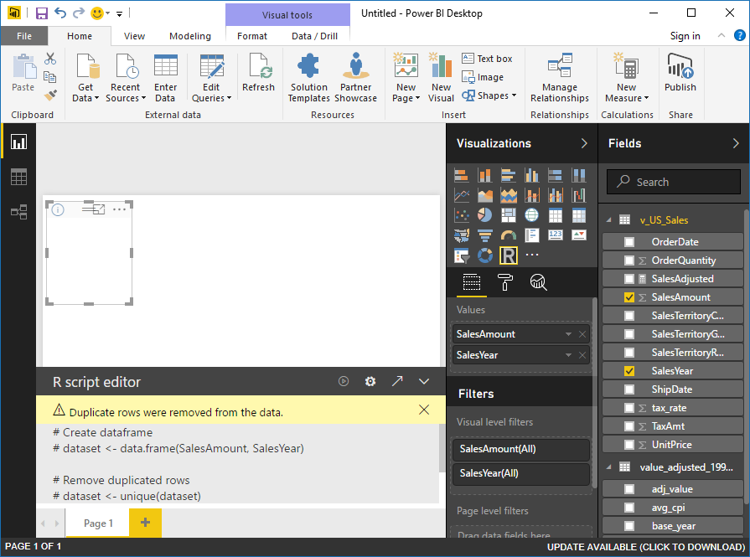
Visualizations with R
Data passed to Script as dataset data frame.

Slide 35
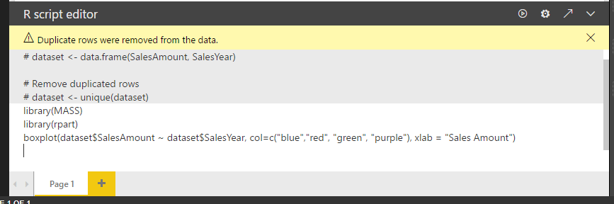
Visualizations with R
Packages must be installed.
Code renders visualization.

Slide 36
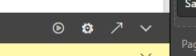
Visualizations with R
Run Script
Script Options
Go To R IDE
Expand/Contract Script Pane

Slide 37

Why is Spock’s shirt blue in Star Trek The Original Series?

Slide 38
Why is Spock’s shirt blue in Star Trek The Original Series?
Blue stands for Science and Medical Service.

Slide 39
Demo
Visualizations from an R Script
r_visualization.r

Slide 40
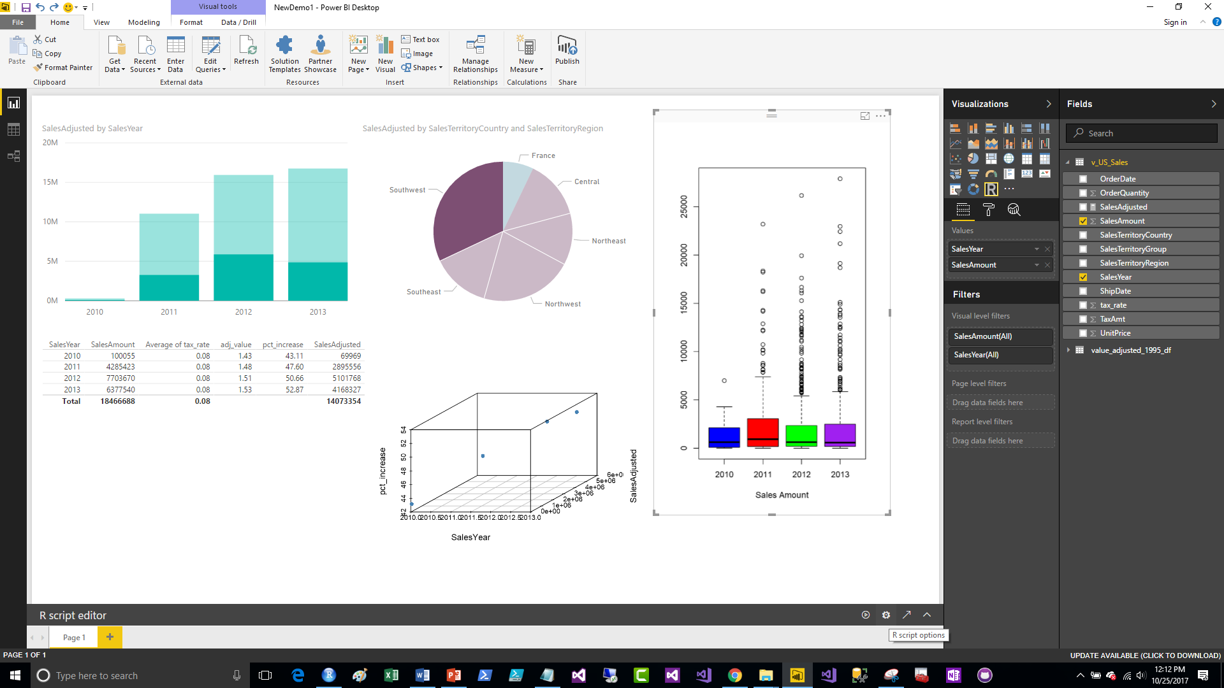
Visualizations with R
Click to Edit R Script

Slide 41
Demo with Predictive Model

Slide 42
Data Sources
Built In R Data
data()
MRAN
R Packages that Get Data
https://mran.microsoft.com/documents/data/
http://blog.revolutionanalytics.com/2016/01/new-data-sources-for-r.html

Slide 43
Review
R is a popular open source data science language.
The Comprehensive R Archive Network (CRAN) maintains R.
R has rich support for statistics and visualizations.
R is a vectorized language.
R is Extended with new Functionality via Packages.

Slide 44

Q & A
Data Solutions Consultant and Trainer.
Decades of IT Experience in health care, insurance, banking, and ecommerce.
Microsoft MVP.
Author of Pro PowerShell for Database Developers.
Founded and lead PASS Chapter The RI Microsoft BI User Group and The SNE R User Group.
Frequent presenter at technical conferences and user groups.
https://www.linkedin.com/in/bryancafferky
@BryanCafferky – follow me!
Subscribe to me on YouTube!

